Slide 1
Employee Data Analysis using Excel
STUDENT NAME: E.ABI
REGISTER NO : 122204251/asunm1683122204251
DEPARTMENT : B.COM ( CORPORATE SECRETARYSHIP)
COLLEGE : GOVT ARTS AND SCIENCE COLLEGE
RKNAGAR CHENNAI-81
COLLEGE COGE : 1683

Slide 2
PROJECT TITLE
Employee Attendance Analysis using Excel

Slide 3


AGENDA
Problem Statement
Project Overview
End Users
Our Solution and Proposition
Dataset Description
Modelling Approach
Results and Discussion
Conclusion
3/21/2024 Annual Review

Slide 4

PROBLEM STATEMENT
Attendance Management System is software developed for daily student attendance in schools, colleges and institutes. It facilitates to access the attendance information of a particular student in a particular class. This system will also help in evaluating attendance eligibility criteria of a student. By just a click on the mouse, the system will be able to produce the students' attendance report thus reducing the need for manual labour which is prone to human errors and time consuming.

Slide 5

PROJECT OVERVIEW
The Attendance Management System project was developed to help employers
track and monitor their employees. It's the system used to track how much time the
workers spend working and how much time they spend off. This attendance management
system project report talks about all of its documentation, like the project abstract,
modules, and more

Slide 6

WHO ARE THE END USERS?
1. Data Input:
2. Real-time Tracking:
3. Automated Calculations:
4. Reporting:
5. Integration:

Slide 7

OUR SOLUTION AND ITS VALUE PROPOSITION
the attendance policy (see above) in all its dimensions
the shift roster
holiday calendar
the leave status of the employee for the day
any special permissions or exceptions for the employee

Slide 8
Dataset Description attendance-create columns and rows Features-12 Employee id- number Name- Letter Employee type-text Gender- Male,female

Slide 9

THE "WOW" IN OUR SOLUTION
Performance level=IFS
(G6>=9,”VERY HIGH”,X7>5”HIGH”,
MED”,TRUE”LOW”)
3/21/2024 Annual Review
9

Slide 10
MODELLING
Step 1: access the data you need.
Step 2: identify spikes using historic data and national data.
Step 3: ask questions and investigate patterns and trends.
Plan your next steps.
10

Slide 11
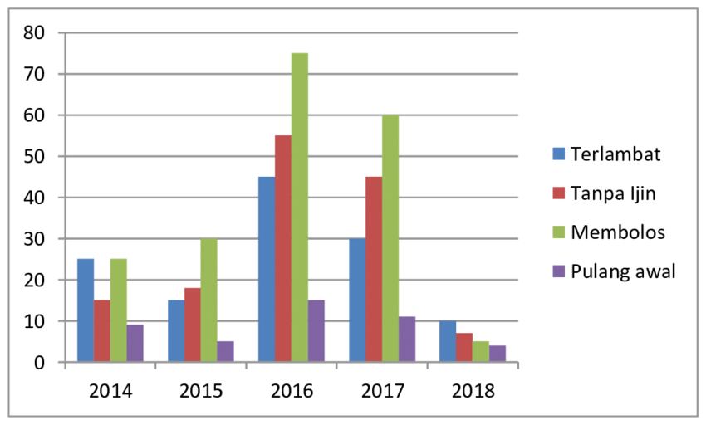
RESULTS
11

Slide 12
conclusion
he attendance rules are very strictly implemented. Students are sometimes not allowed to give exams because of lack of attendance. If not that, then internal marks are affected. Parents support this wholeheartedly because there is a preconceived notion that quality of a child’s education is directly proportional to the number of classes

